Slide 1
UMD DATA605 - Big Data Systems Streaming and Real-Time Analytics
Apache Storm
Spark Streaming
GP Saggese
gsaggese@umd.edu
with thanks to Amol Deshpande,
M. Fukuda (U. Washington), T. De Matteis (U. Pisa),
S. Rahim (American Int. U.), T. Das (UC Berkeley)

Slide 2
Motivation
Much data generated continuously (growing every day)
Financial data
Sensors, RFID
Network/systems monitoring
Video/Audio data
Etc.
Need to support:
High data rates
Real-time processing with low latencies
Support for temporal reasoning (time-series operations)
Data dissemination
Distributed operation (at least data generation)
And more

Slide 3
Motivation
Examples of Tasks
Continuous (SQL) queries
E.g. moving average over last hour every 10 mins
SQL extended to support windows over streams
Proposed extensions: SEQUENCE, CQL, StreamSQL
Pattern recognition
Alert me when: $A$, then $B$ within 10 mins
How to specify?
StreamSQL has some support
Probabilistic modeling Applying financial models
Infer hidden variables
Remove noise (from measured readings)
Do complex analysis to decide whether to buy
We don't even know how to specify these
Multimedia data
Online object detection, activity detection
Correlating events from different streams

Slide 4
Why can't we use traditional RDBMS?
Consider simplest case:
Report moving average over last hour every 10 minutes
Insert all new items into database
Execute the query every 10 minutes
Not easily generalizable to other tasks
E.g., ``alert me when the moment moving average is > 100'' ?
Typically 1000's of such continuous queries
Even for one query, too slow and inefficient
Doesn't reuse work from previous execution
Application-level modules typically used for complex tasks

Slide 5
Related Concepts
Triggers
Similar, but recent/current trigger systems not designed for the required scale
Publish-Subscribe Systems
Similar concepts: Push-based, reactive execution
Typically no complex queries
Much focus on dissemination

Slide 6
Research Systems
Major research systems focused on data streaming for relational data (late 90's-early 00's):
NiagaraCQ (Wisc), Telegraph, TelegraphCQ (Berkeley), STREAM (Stanford), Aurora, Borealis, Medusa (Brown/Brandeis/MIT)
Commercial: Oracle*Streams, Streambase, etc.
Many questions explored in depth, but no real unifying theme or consensus emerged
Today support for streams in standard RDBMS somewhat ad hoc
There are also many specialized vertical tools for specific applications (e.g., finance)
Also a lot of theoretical work
Especially on one-pass algorithms, where you only get one look at the data

Slide 7
NoSQL and Streams
Streaming and real-time analytics has re-emerged in recent years in the NoSQL world
A detailed motivation/rationale by the Apache Storm Project
Key differentiations analogous to the differentiation between relational databases and MapReduce-style systems
Focus on distributed, fault-tolerant execution at scale
Eschew any specific data model, but rather allow users to write arbitrary computations easily
Some key systems:
Apache Storm
Spark Streaming
LogStash
focus more on log data analysis
Messaging systems
ZeroMQ
RabbitMQ
Kafka, etc.
Somewhat fragmented and rapidly evolving space, with much active work

Slide 8
Apache Storm

Slide 9
Storm Introduction
Apache Storm is a real-time, fault-tolerant, distributed Stream Processing Engine.
Main languages – Clojure and Java
Core concepts:
tuple: a named list of values
stream: a (possibly) unbounded sequence of tuples processed by the application

Slide 10
Storm Rationale
Before Storm, developer would typically have to manually build a network of queues and workers to do real-time processing
Workers process messages off a queue, update databases, and send new messages to other queues for further processing
Limitations
Tedious: Developer spends most of time configuring where to send messages, deploying workers, and deploying intermediate queues. Realtime processing logic for the application is only a relatively small part of the developed code.
Brittle: Little fault-tolerance. Developer responsible for keeping each worker and queue up and running.
Painful to scale: When the message throughput gets too high for a single worker or queue, developer must partition how the data is spread around. Developer must reconfigure the other workers to know the new locations to send messages.
More opportunities for failures
From: http://storm.apache.org/releases/current/Rationale.html

Slide 11
Storm Key Properties
Extremely broad set of use cases:
Storm can be used for processing messages and updating databases (stream processing), doing a continuous query on data streams and streaming the results into clients (continuous computation), parallelizing an intense query like a search query on the fly (distributed RPC), and more. Storm's small set of primitives satisfy many use cases.
Scalable:
Storm scales to massive numbers of messages per second. To scale a topology, add machines and increase the parallelism settings of the topology. As an example of Storm's scale, one of Storm's initial applications processed 1,000,000 messages per second on a 10 node cluster, including hundreds of database calls per second as part of the topology. Storm's usage of Zookeeper for cluster coordination makes it scale to much larger cluster sizes.
Guarantees no data loss:
A realtime system must have strong guarantees about data being successfully processed. A system that drops data has a very limited set of use cases. Storm guarantees that every message will be processed, in direct contrast with other systems, like S4 (Yahoo).
From: http://storm.apache.org/releases/current/Rationale.html

Slide 12
Storm Key Properties
Extremely robust:
Unlike systems like Hadoop, which are notorious for being difficult to manage, Storm clusters just work. It is an explicit goal of the Storm project to make the user experience of managing Storm clusters as painless as possible.
Fault-tolerant:
If there are faults during execution of the computation, Storm will reassign tasks as necessary. Storm makes sure that a computation can run forever (or until admin kills the computation).
Programming language agnostic:
Robust and scalable realtime processing not limited to a single platform. Storm topologies and processing components can be defined in any language, making Storm highly accessible.
From: http://storm.apache.org/releases/current/Rationale.html

Slide 13
Storm data model
Basic unit of data that can be processed by a Storm application is a tuple
Each tuple consists of a predefined list of fields
The value of each field can be a byte, char, integer, long, float, double, Boolean, or byte array
Storm also provides an API to define your own data types, which can be serialized as fields in a tuple
A tuple is dynamically typed, so you just need to define the names of the fields in a tuple and not their data type
Fields in a tuple can be accessed by its name getValueByField(String) or its positional index getValue(int)

Slide 14
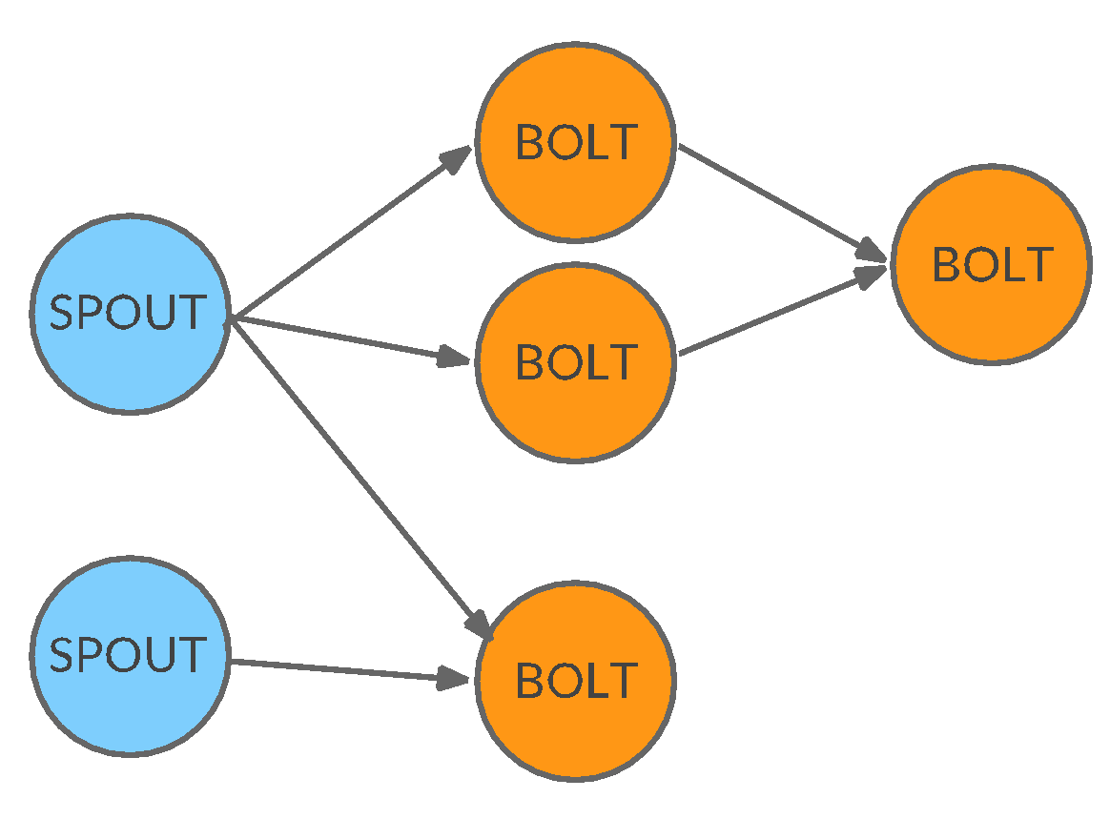
Basics
A Streaming Application is defined in Storm by means of a topology that describes its logic as a graph of operators and streams. Can have two types of operators:
spouts: are the sources of streams in a topology. Generally will read tuples from external sources (e.g., Twitter API) or from disk and emit them in the topology
bolts: process input streams and produce output streams. They encapsulate the application logic

Slide 15
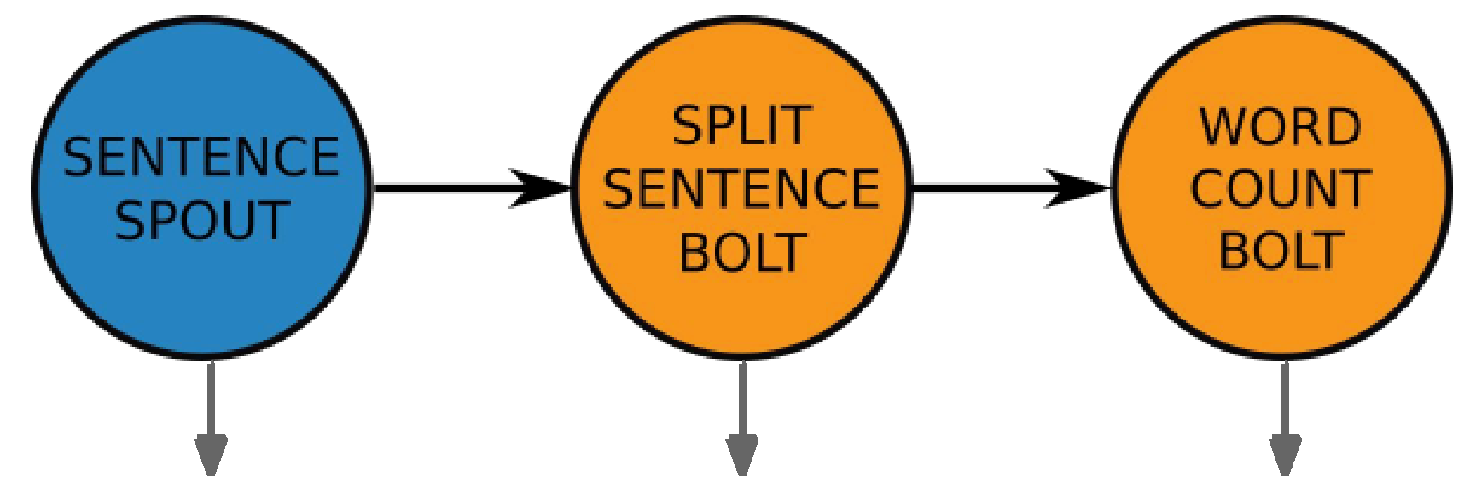
Topology Example
Word Count: count the different words in a stream of sentences
SentenceSpout: emits a stream of tuples that represent sentences:
{sentence: “my dog has fleas”} SplitSentenceBolt: emits a tuple for each word in the sentences it receives:
{word: “my”}; {word:”dog”}; ... WordCountBolt: updates the count and at save it to file.
Implemented by 3 classes and composed to obtain the desired topology:
TopologyBuilder builder = new TopologyBuilder(); builder.setSpout("sentences-spout", new SentenceSpout()); builder.setBolt("split-bolt", new SplitSentenceBolt()) .shuffleGrouping("sentences-spout"); builder.setBolt("count-bolt", new WordCountBolt()) .fieldsGrouping("split-bolt", new Fields("word"));

Slide 16
Topology Example
public class SplitSentenceBolt extends BaseRichBolt { private OutputCollector collector;
public void declareOutputFields(OutputFieldsDeclarer declarer) { declarer.declare(new Fields("word"));
}
public void prepare(Map config, TopologyContext context, OutputCollector collector) { this.collector = collector;
}
public void execute(Tuple tuple) {
String sentence = tuple.getStringByField("sentence"); String[] words = sentence.split(" ");
for(String word : words){ this.collector.emit(new Values(word)); } } }

Slide 17
Topology Example
public class WordCountBolt extends BaseRichBolt { private OutputCollector collector; private HashMap<String,Long> counts=null;
public void declareOutputFields(OutputFieldsDeclarer declarer) { //this bolt does not emit anything
}
public void prepare(Map config, TopologyContext context, OutputCollector collector) { this.collector = collector; this.counts = new HashMap<String,Long>();
}
public void execute(Tuple tuple) { String word = tuple.getStringByField("word"); // … increments count .. } }
Notes:
SentenceSpout: emits a stream of tuples that represents sentences:
{sentence: “my dog has fleas”}
SplitSentenceBolt: emits a tuple for each word in the sentences it receives:
{word: “my”}; {word:”dog”}; ...
WordCountBolt: updates the count and at save it to file.
Each node extends some abstract classes and must implements some basic methods for defining the format of the tuple emitted, the logic and so on…

Slide 18
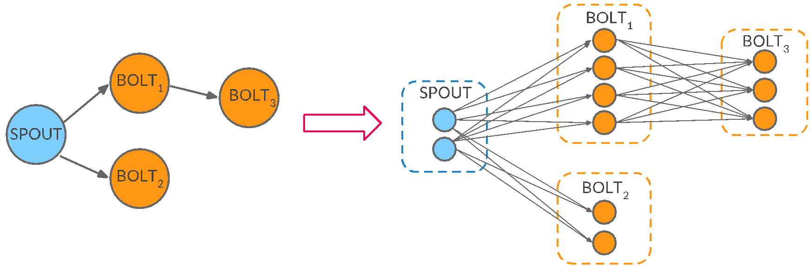
Application Deployment
When executed, the topology is deployed as a set of processing entities over a set of computational resources (typically a cluster). Parallelism is achieved in Storm by running multiple replicas of the same spout/bolt
Groupings specify how tuples are routed to the various replicas

Slide 19
Groupings
7 built-in possibilities, the most interesting are:
shuffle grouping: tuples are randomly distributed
field grouping: the stream is partitioned according to a tuple attribute. Tuples with the same attribute will be scheduled to the same replica
all grouping: tuples are replicated to all replicas
direct grouping: the producer decides the destination replica
global grouping: all the tuples go to the same replica (e.g., lowest ID)
Users also have the possibility of implementing their own grouping through the CustomStreamGrouping interface

Slide 20
Guaranteed Processing
Storm provides an API to guarantee that a tuple emitted by a spout is fully processed by the topology (at-least-once semantic)
A tuple coming from a spout can trigger thousands of tuples to be created based on it. Consider the WordCount example:
the spout generates sentences (tuples)
the bolt generates a set of words for each sentence (child tuples)
A tuple is fully processed iff it and all its child tuples have been correctly processed by the topology

Slide 21
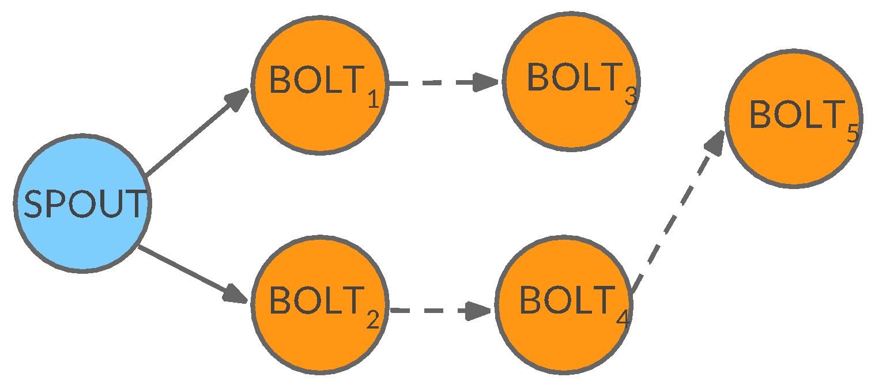
Guaranteed Processing
Another way to look at it is to consider the tuple tree:
the solid lines represent the tuple emitted by the spout
the dashed ones are the child tuples generated by the bolts
With guaranteed processing, each bolt in the tree can either acknowledge or fail a tuple:
If all bolts in the tree acknowledge the tuple and child tuples the message processing is complete
If any bolts explicitly fail a tuple, or exceed a time-out period, the processing is failed

Slide 22
Guaranteed Processing
From the Spout side, have to keep track of the tuples emitted and be prepared to handle fails:
public void nextTuple() { // prepare the next sentence S to emit this.collector.emit(new Values(S), msgID); // … }
public void ack(Object msgID) { // handle success
// … }
public void fail(Object msgID) { // handle failure
// … }
Assign a unique ID to any emitted tuple
Implement the ack and fail methods for handling successes and failures

Slide 23
Guaranteed Processing
On the Bolts side, have to anchor any emitted tuple to the originating one and to acknowledging or failing tuples
public void execute(Tuple tuple) { // … processing …
this.collector.emit(tuple, new Values(word)); // acknowledgment this.collector.ack(tuple); // or, if something goes wrong, fail this.collector.fail(tuple); }

Slide 24
Internal Architecture
Nimbus-Master Node
Assigns tasks
Monitors failures
Zookeeper
Maintains cluster state of Nimbus and Supervisor
Supervisor
Communicates with Nimbus through Zookeeper about topologies and available resources.
Workers
Listen for assigned work and execute the application.
Nimbus
Zookeeper
Zookeeper
Zookeeper
Supervisor
Supervisor
Supervisor
Supervisor
Workers
Workers
Workers
Workers
Notes:
Change the diagram

Slide 25
Storm Architecture
Two kinds of nodes in a Storm cluster:
Master node: runs Nimbus, a central job master to which topologies are submitted. It is in charge of scheduling, job orchestration, communication and fault tolerance
Worker nodes: nodes of the cluster in which applications are executed. Each of them run a Supervisor, that communicates with Nimbus about topologies and available resources
The coordination between the two entities is done through Zookeper that is also used for fault tolerance

Slide 26
Storm components: Nimbus
Nimbus:
is the master in a Storm cluster
Is responsible for:
distributing application code across various worker nodes
assigning tasks to different machines
monitoring tasks for any failures
restarting them as and when required
Stateless
Stores all of its data in ZooKeeper
Only one Nimbus node in a Storm Cluster
Can be restarted without having any effects on the already running tasks on the worker nodes

Slide 27
Storm components: Supervisor nodes
Supervisor nodes
are the worker nodes in a Storm cluster
Each supervisor node runs a supervisor daemon that is responsible for:
creating,
Starting and
Stopping
worker processes to execute the tasks assigned to that node
Like Nimbus, a supervisor daemon is also fail-fast and stores all of its state in ZooKeeper so that it can be restarted without any state loss
A single supervisor daemon normally handles multiple worker processes

Slide 28
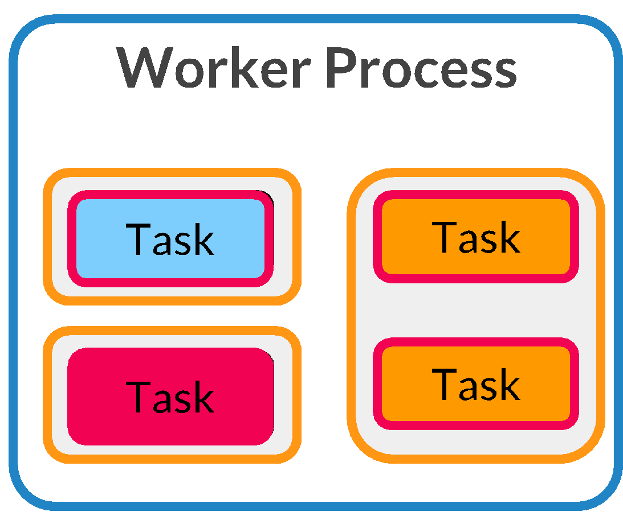
Storm Architecture
Three entities are involved in running a topology:
Worker: 1+ per cluster node, each one is related to one topology
Executor: thread spawned by the Worker. It runs one or more tasks for the same component (bolt or spout)
Task: a component replica
Therefore Workers provide inter-topology parallelism, Executors intra-topology and Tasks intra-component
By default there is a 1:1 association between Executor and Tasks

Slide 29
Interaction between Storm Internal Components
Events - Heartbeat protocol (every 15 seconds), synchronize supervisor event(every 10 seconds) and synchronize process event(every 3 seconds).
Submits
topology
Advertises
Topology
Client
Nimbus
Supervisors*
Match
making
Executors*
Workers*
Processes Tasks
Spawns Workers
Notes:
-Client submits the topology to Nimbus.
-Supervisor contacts Nimbus and advertises the current running topology and any vacancies to run more topologies.
-Nimbus does the match-making between the pending topology and the supervisors.
-Nimbus distributes the work.
-Based on the job assignment, Supervisors spawns workers.
-Each worker process runs one or more Executors and executors are in turn made up of one or more tasks.
-The actual work for a bolt or a spout is done in the task.

Slide 30
On Top of Storm
Various libraries/frameworks have been developed on top:
Storm Trident: a library that provides micro-batching and high level constructs (e.g. groupBy, aggregates, join)
Like Spark Streaming
Yahoo/Apache Samoa: a distributed streaming machine learning (ML) framework that can run on top of Storm
Twitter Summingbird: streaming MapReduce

Slide 31
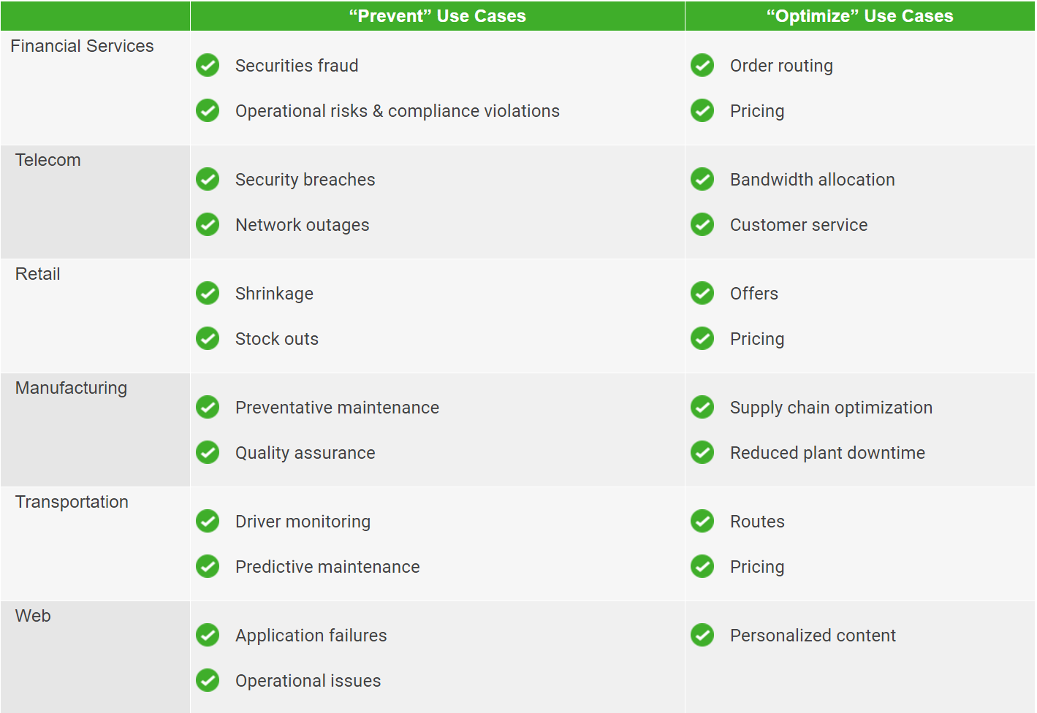
Storm Use Cases

Slide 32
Comparison of big data tools
A Storm cluster is superficially similar to a Hadoop cluster
on Hadoop you run MapReduce jobs, on Storm you run “topologies”
Jobs and “topologies are very different — one key difference is that a MapReduce job eventually finishes, whereas a topology processes messages forever (or until you kill it).
Storm can do real time processing of streams of tuple’s (incoming data) while Hadoop does batch processing in a MapReduce job
Storm behaves like true streaming processing systems with lower latencies, while Spark is able to handle higher throughput while having somewhat higher latencies.
Storm is better choice for real time data processing
Reference: “Benchmarking Streaming Computation Engines: Storm, Flink and Spark Streaming”, By S. Chintapalliet al., Yahoo Inc., Presented at 2016 IEEE International Parallel and Distributed Processing Symposium Workshops
Notes:
Add the paper

Slide 33
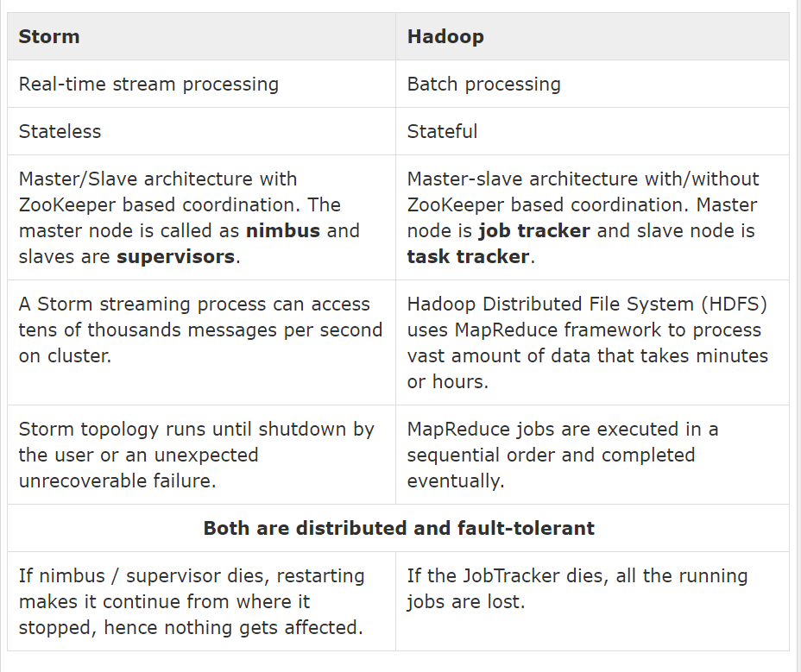
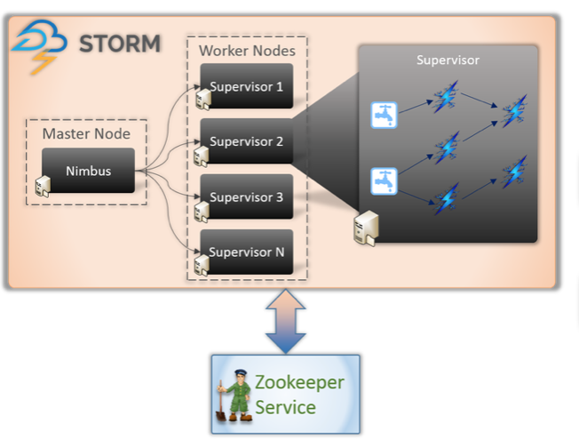
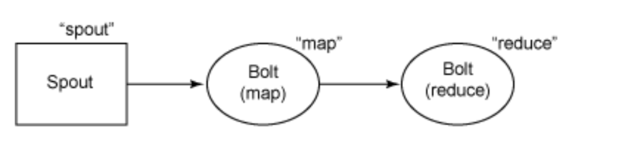
Storm vs. Hadoop
Notes:
Storm is stateless but with Zookeeper Storm maintain states.

Slide 34
Storm- Pros and Cons
Pros
Fault tolerance: High fault tolerance
Latency: less than for batch processing system
Processing Model: Real-time stream processing model
Programming language dependency: any programming language
Reliable: each tuple of data should be processed at least once
Scalability: high scalability
Cons
Use of native scheduler and resource management feature (Nimbus) in particular, can become bottlenecks
Difficulties with debugging given the way the threads and data flows are split
Notes:
Because of first con Twitter switched from Storm to Twitter Heron

Slide 35
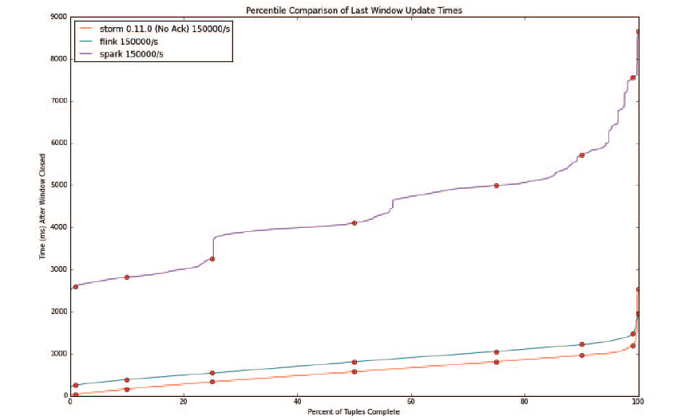
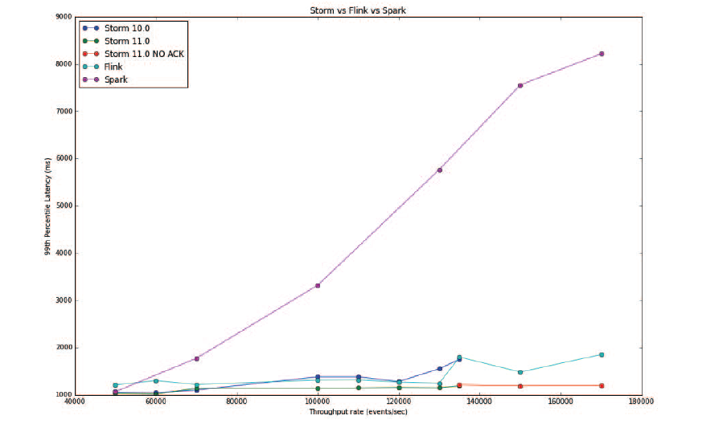
Benchmarking Streaming Computation Engines: Storm, Flink and Spark Streaming
Notes:
Referred paper “Benchmarking Streaming Computation Engines: Storm, Flink and Spark Streaming”. As per the paper, they closely mimicked the real-world production scenarios and provided a performance comparison of the three data engines.
The throughput vs latency graph for the various systems is explaining that Flink and Storm have very similar performance, and Spark Streaming, while it has much higher latency, is expected to be able to handle much higher throughput by configuring its batch interval higher. The reason why Spark has higher latency because of micro-batching methodology as compared to the pure streaming nature of Storm.

Slide 36
Spark Streaming

Slide 37
What is Spark Streaming?
Extends Spark for doing large scale stream processing
Scales to 100s of nodes and achieves second scale latencies
Efficient and fault-tolerant stateful stream processing
Simple batch-like API for implementing complex algorithms

Slide 38

Integration with Batch Processing
Many environments require processing same data in live streaming as well as batch post processing
Existing framework cannot do both
Either do stream processing of 100s of MB/s with low latency
Or do batch processing of TBs / PBs of data with high latency
Extremely painful to maintain two different stacks
Different programming models
Double the implementation effort
Double the number of bugs

Slide 39

Stateful Stream Processing
Traditional streaming systems have a record-at-a-time processing model
Each node has mutable state
For each record, update state and send new records
mutable state
input
records
node 1
node 3
input
records
State is lost if node dies!
Making stateful stream processing be fault-tolerant is challenging
node 2
Notes:
Traditional streaming systems have what we call a “record-at-a-time” processing model. Each node in the cluster processing a stream has a mutable state. As records arrive one at a time, the mutable state is updated, and a new generated record is pushed to downstream nodes. Now making this mutable state fault-tolerant is hard.

Slide 40
Existing Streaming Systems
Storm
Replays record if not processed by a node
Processes each record at least once
May update mutable state twice!
Mutable state can be lost due to failure
Trident – Use transactions to update state
Processes each record exactly once
Per state transaction to external database is slow

Slide 41
Discretized Stream Processing
Run a streaming computation as a series of very small, deterministic batch jobs
live data stream
Spark
Streaming
Chop up the live stream into batches of X seconds
Spark treats each batch of data as RDDs and processes them using RDD operations
Finally, the processed results of the RDD operations are returned in batches
batches of X seconds
Spark
processed results

Slide 42
Discretized Stream Processing
Run a streaming computation as a series of very small, deterministic batch jobs
live data stream
Spark
Streaming
Batch sizes as low as ½ second, latency of about 1 second
Potential for combining batch processing and streaming processing in the same system
batches of X seconds
Spark
processed results

Slide 43
Key concepts
DStream – sequence of RDDs representing a stream of data
Twitter, HDFS, Kafka, Flume, ZeroMQ, Akka Actor, TCP sockets
Can write a receiver for your own data source too
Transformations – modify data from one DStream to another
Standard RDD operations – map, countByValue, reduce, join, …
Stateful operations – window, countByValueAndWindow, …
Output Operations – send data to external entity
saveAsHadoopFiles – saves to HDFS
foreach – do anything with each batch of results

Slide 44
Example – Get hashtags from Twitter
val tweets = ssc.twitterStream()
DStream: a sequence of RDDs representing a stream of data
Twitter Streaming API
batch @ t+1
batch @ t
batch @ t+2
tweets DStream
stored in memory as an RDD (immutable, distributed)

Slide 45
Example – Get hashtags from Twitter
val tweets = ssc.twitterStream()
val hashTags = tweets.flatMap (status => getTags(status))
new DStream
transformation: modify data in one DStream to create another DStream
batch @ t
batch @ t+1
batch @ t+2
tweets DStream
flatMap
flatMap
flatMap
hashTags Dstream
[#cat, #dog, … ]
…
new RDDs created for every batch

Slide 46
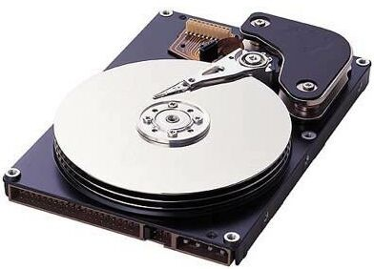
Example – Get hashtags from Twitter
val tweets = ssc.twitterStream()
val hashTags = tweets.flatMap (status => getTags(status))
hashTags.saveAsHadoopFiles("hdfs://...")
output operation: to push data to external storage
batch @ t
batch @ t+1
batch @ t+2
tweets DStream
flatMap
flatMap
flatMap
hashTags DStream
save
save
save
every batch saved to HDFS

Slide 47
Example – Get hashtags from Twitter
val tweets = ssc.twitterStream()
val hashTags = tweets.flatMap (status => getTags(status))
hashTags.foreach(hashTagRDD => { ... })
foreach: do whatever you want with the processed data
batch @ t
batch @ t+1
batch @ t+2
tweets DStream
flatMap
flatMap
flatMap
hashTags DStream
foreach
foreach
foreach
Write to database, update analytics UI, do whatever you want

Slide 48
Java Example
Scala
val tweets = ssc.twitterStream()
val hashTags = tweets.flatMap (status => getTags(status))
hashTags.saveAsHadoopFiles("hdfs://...")
Java
JavaDStream<Status> tweets = ssc.twitterStream()
JavaDstream<String> hashTags = tweets.flatMap(new Function<...> { })
hashTags.saveAsHadoopFiles("hdfs://...")
Function object

Slide 49
Window-based Transformations
val tweets = ssc.twitterStream()
val hashTags = tweets.flatMap (status => getTags(status))
val tagCounts = hashTags.window(Minutes(1), Seconds(5)).countByValue()
sliding window operation
window length
sliding interval
window length
DStream of data
sliding interval

Slide 50
Arbitrary Stateful Computations
Specify function to generate new state based on previous state and new data
Example: Maintain per-user mood as state, and update it with their tweets
updateMood(newTweets, lastMood) => newMood
moods = tweets.updateStateByKey(updateMood _)

Slide 51
Arbitrary Combinations of Batch and Streaming Computations
Can inter-mix RDD and DStream operations
Example: Join incoming tweets with a spam HDFS file to filter out bad tweets
tweets.transform(tweetsRDD => { tweetsRDD.join(spamHDFSFile).filter(...)
})

Slide 52
Fault-tolerance: Worker
RDDs remember the operations that created them
Batches of input data are replicated in memory for fault-tolerance
Data lost due to worker failure can be recomputed from replicated input data
All transformed data is fault-tolerant, and exactly-once transformations
tweets
RDD
input data replicated
in memory
flatMap
hashTags
RDD
lost partitions recomputed on other workers

Slide 53
Fault-tolerance: Master
Master saves the state of the DStreams to a checkpoint file
Checkpoint file saved to HDFS periodically
If master fails, it can be restarted using the checkpoint file
More information in the Spark Streaming programmer guide
Automated master fault recovery available using write ahead logs

Slide 54
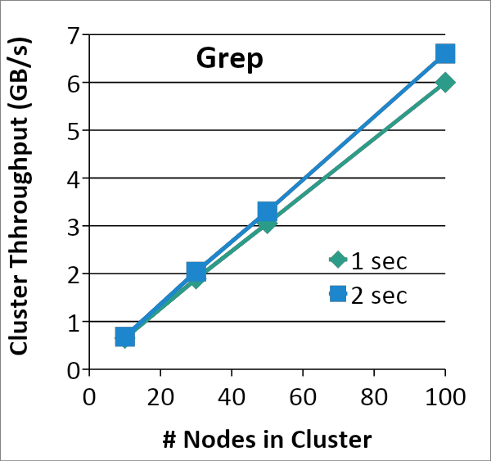
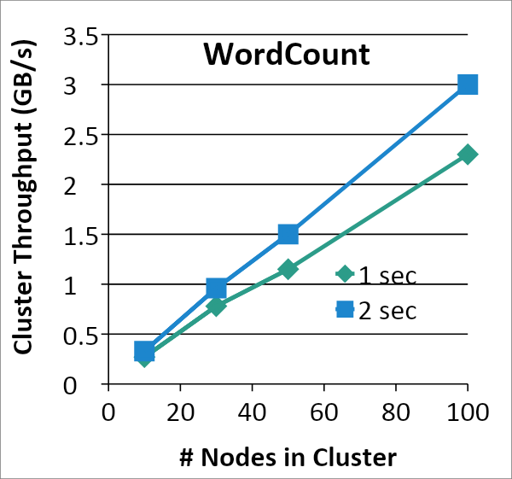
Performance
Can process 6 GB/sec (60M records/sec) of data on 100 nodes at sub-second latency
Tested with 100 text streams on 100 EC2 instances with 4 cores each

Slide 55
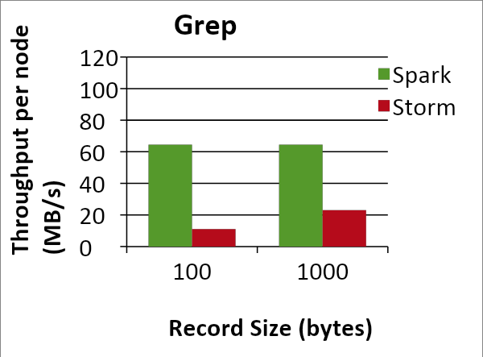
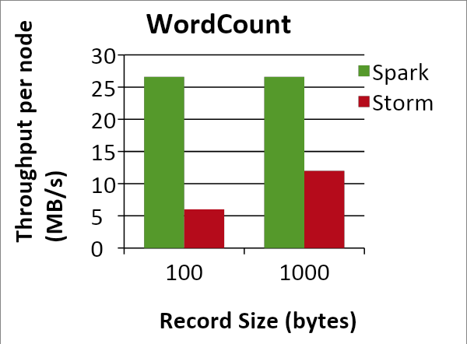
Comparison with Storm and S4
Higher throughput than Storm
Spark Streaming: 670k records/second/node
Storm: 115k records/second/node
Apache S4: 7.5k records/second/node
Notes:
Streaming Spark offers similar speed while providing FT and consistency guarantees that these systems lack

Slide 56
Unifying Batch and Stream Processing Models
Spark program on Twitter log file using RDDs
val tweets = sc.hadoopFile("hdfs://...")
val hashTags = tweets.flatMap (status => getTags(status))
hashTags.saveAsHadoopFile("hdfs://...")
Spark Streaming program on Twitter stream using DStreams
val tweets = ssc.twitterStream()
val hashTags = tweets.flatMap (status => getTags(status))
hashTags.saveAsHadoopFiles("hdfs://...”)

Slide 57
Vision - one stack to rule them all
Explore data interactively using Spark Shell to identify problems
Use same code in Spark standalone programs to identify problems in production logs
Use similar code in Spark Streaming to identify problems in live log streams
$ ./spark-shell
scala> val file = sc.hadoopFile(“smallLogs”)
...
scala> val filtered = file.filter(_.contains(“ERROR”))
...
scala> val mapped = filtered.map(...)
...
object ProcessProductionData {
def main(args: Array[String]) {
val sc = new SparkContext(...)
val file = sc.hadoopFile(“productionLogs”)
val filtered = file.filter(_.contains(“ERROR”))
val mapped = filtered.map(...)
...
}
}
object ProcessLiveStream {
def main(args: Array[String]) {
val sc = new StreamingContext(...)
val stream = sc.kafkaStream(...)
val filtered = file.filter(_.contains(“ERROR”))
val mapped = filtered.map(...)
...
}
}

Slide 58
Apache Storm vs. Spark Streaming
Storm is a true streaming system (handles tuple-at-a-time) and can achieve better latencies
Spark Streaming uses micro-batching and is fundamentally limited in the latencies it can deliver
because it is based on a batch analytics platform, i.e., Spark

